Slide 1

Sentiment (Text) Analysis
Minder Chen, CSU Channel Islands
Copyright (c) 2022, DecisionPro Inc.

Slide 2
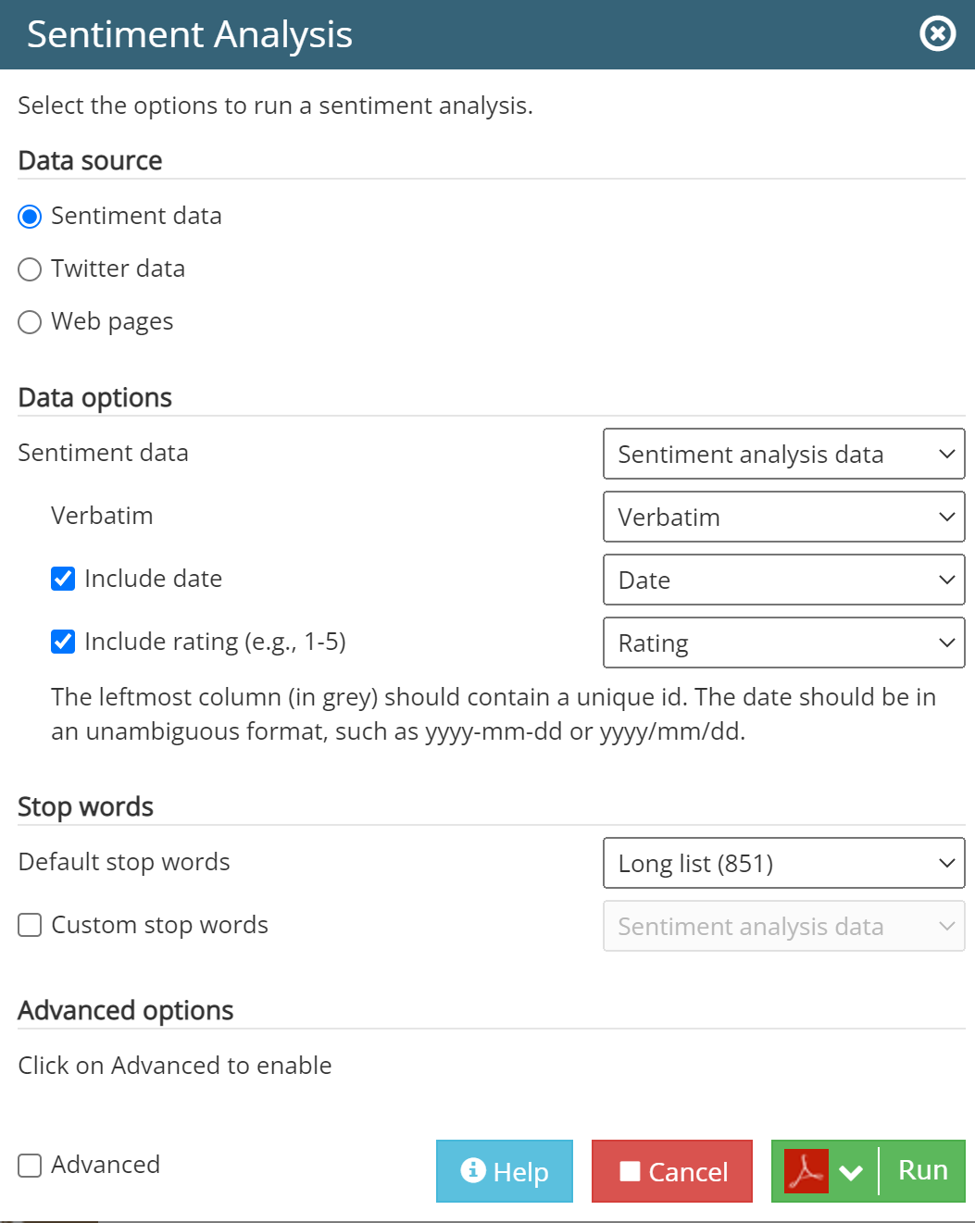

Slide 3
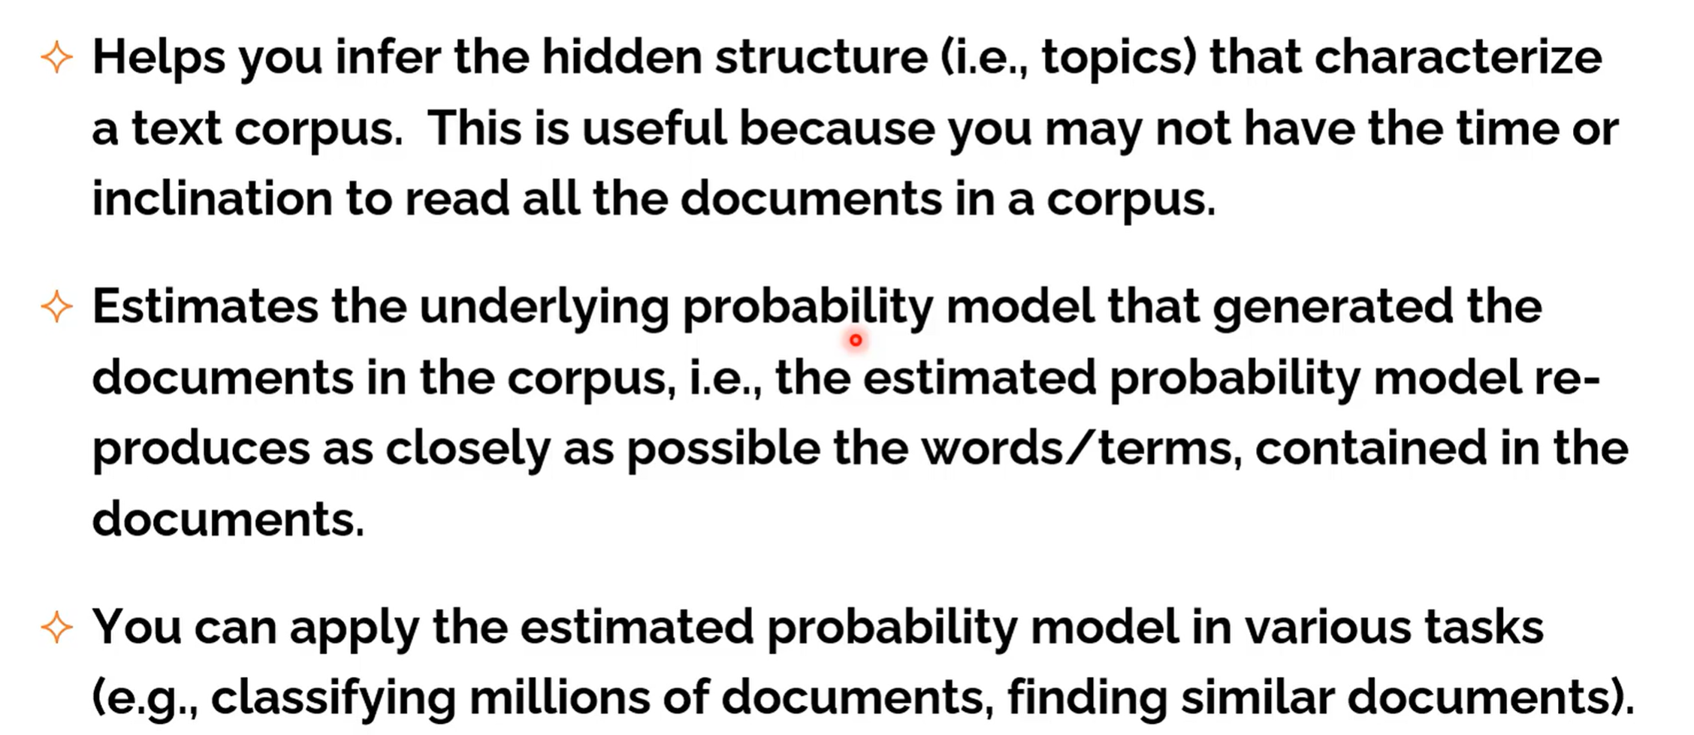
Topic Modeling in a Nutshell

Slide 4
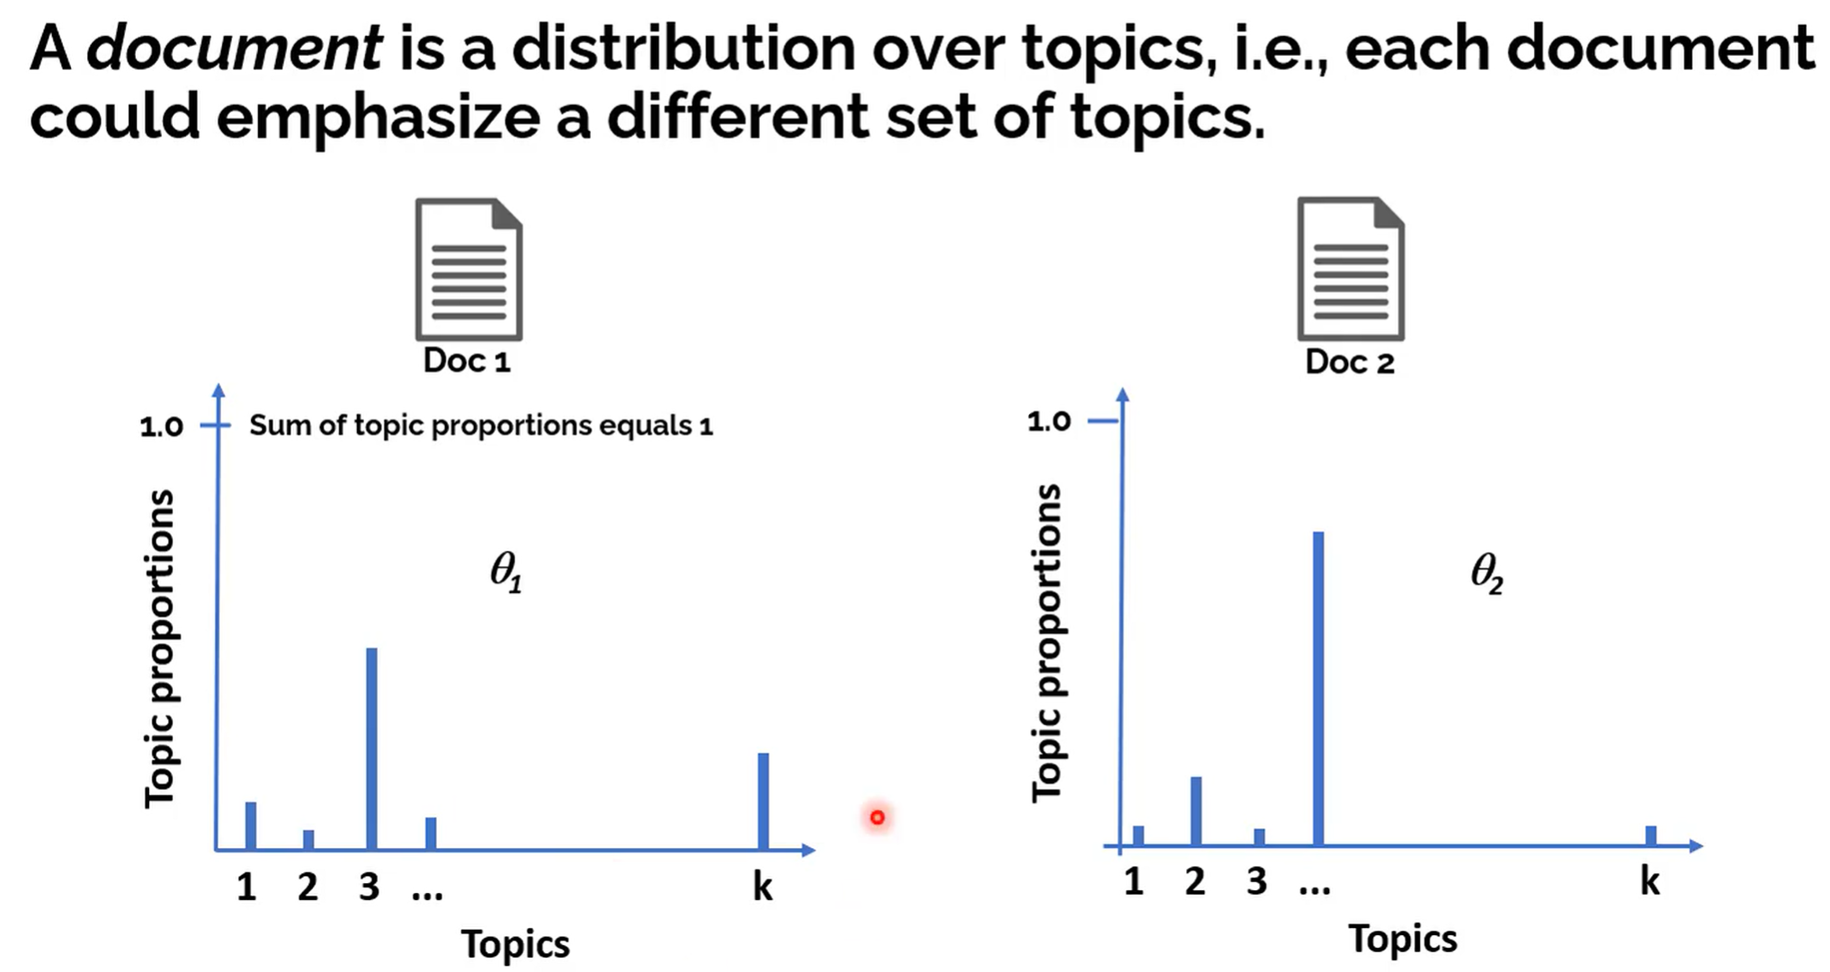
Conceptual Introduction to Topic Modeling

Slide 5
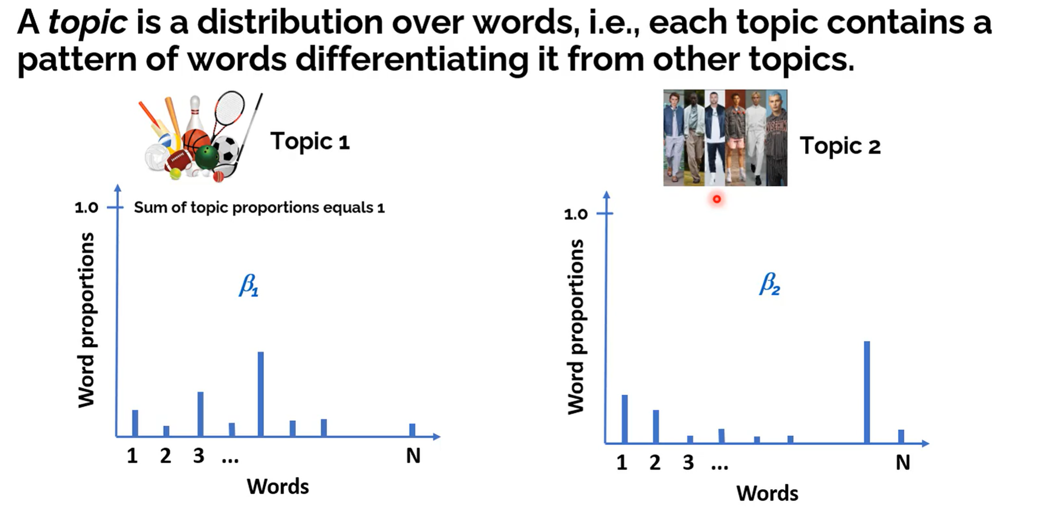
Conceptual Introduction to Topic Modeling

Slide 6
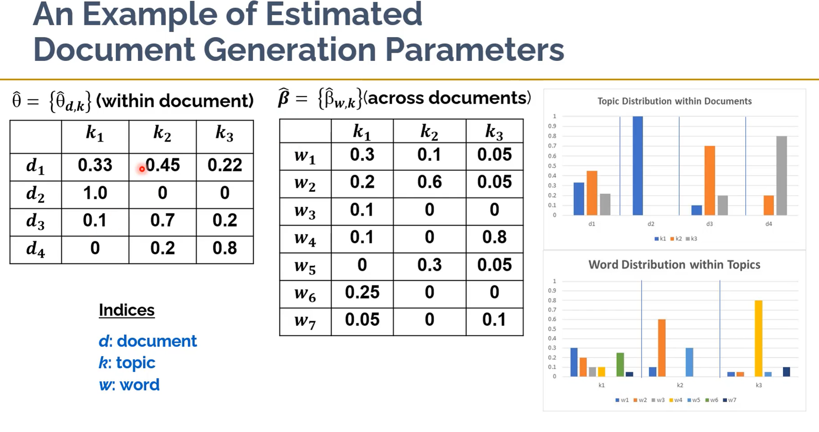

Slide 7
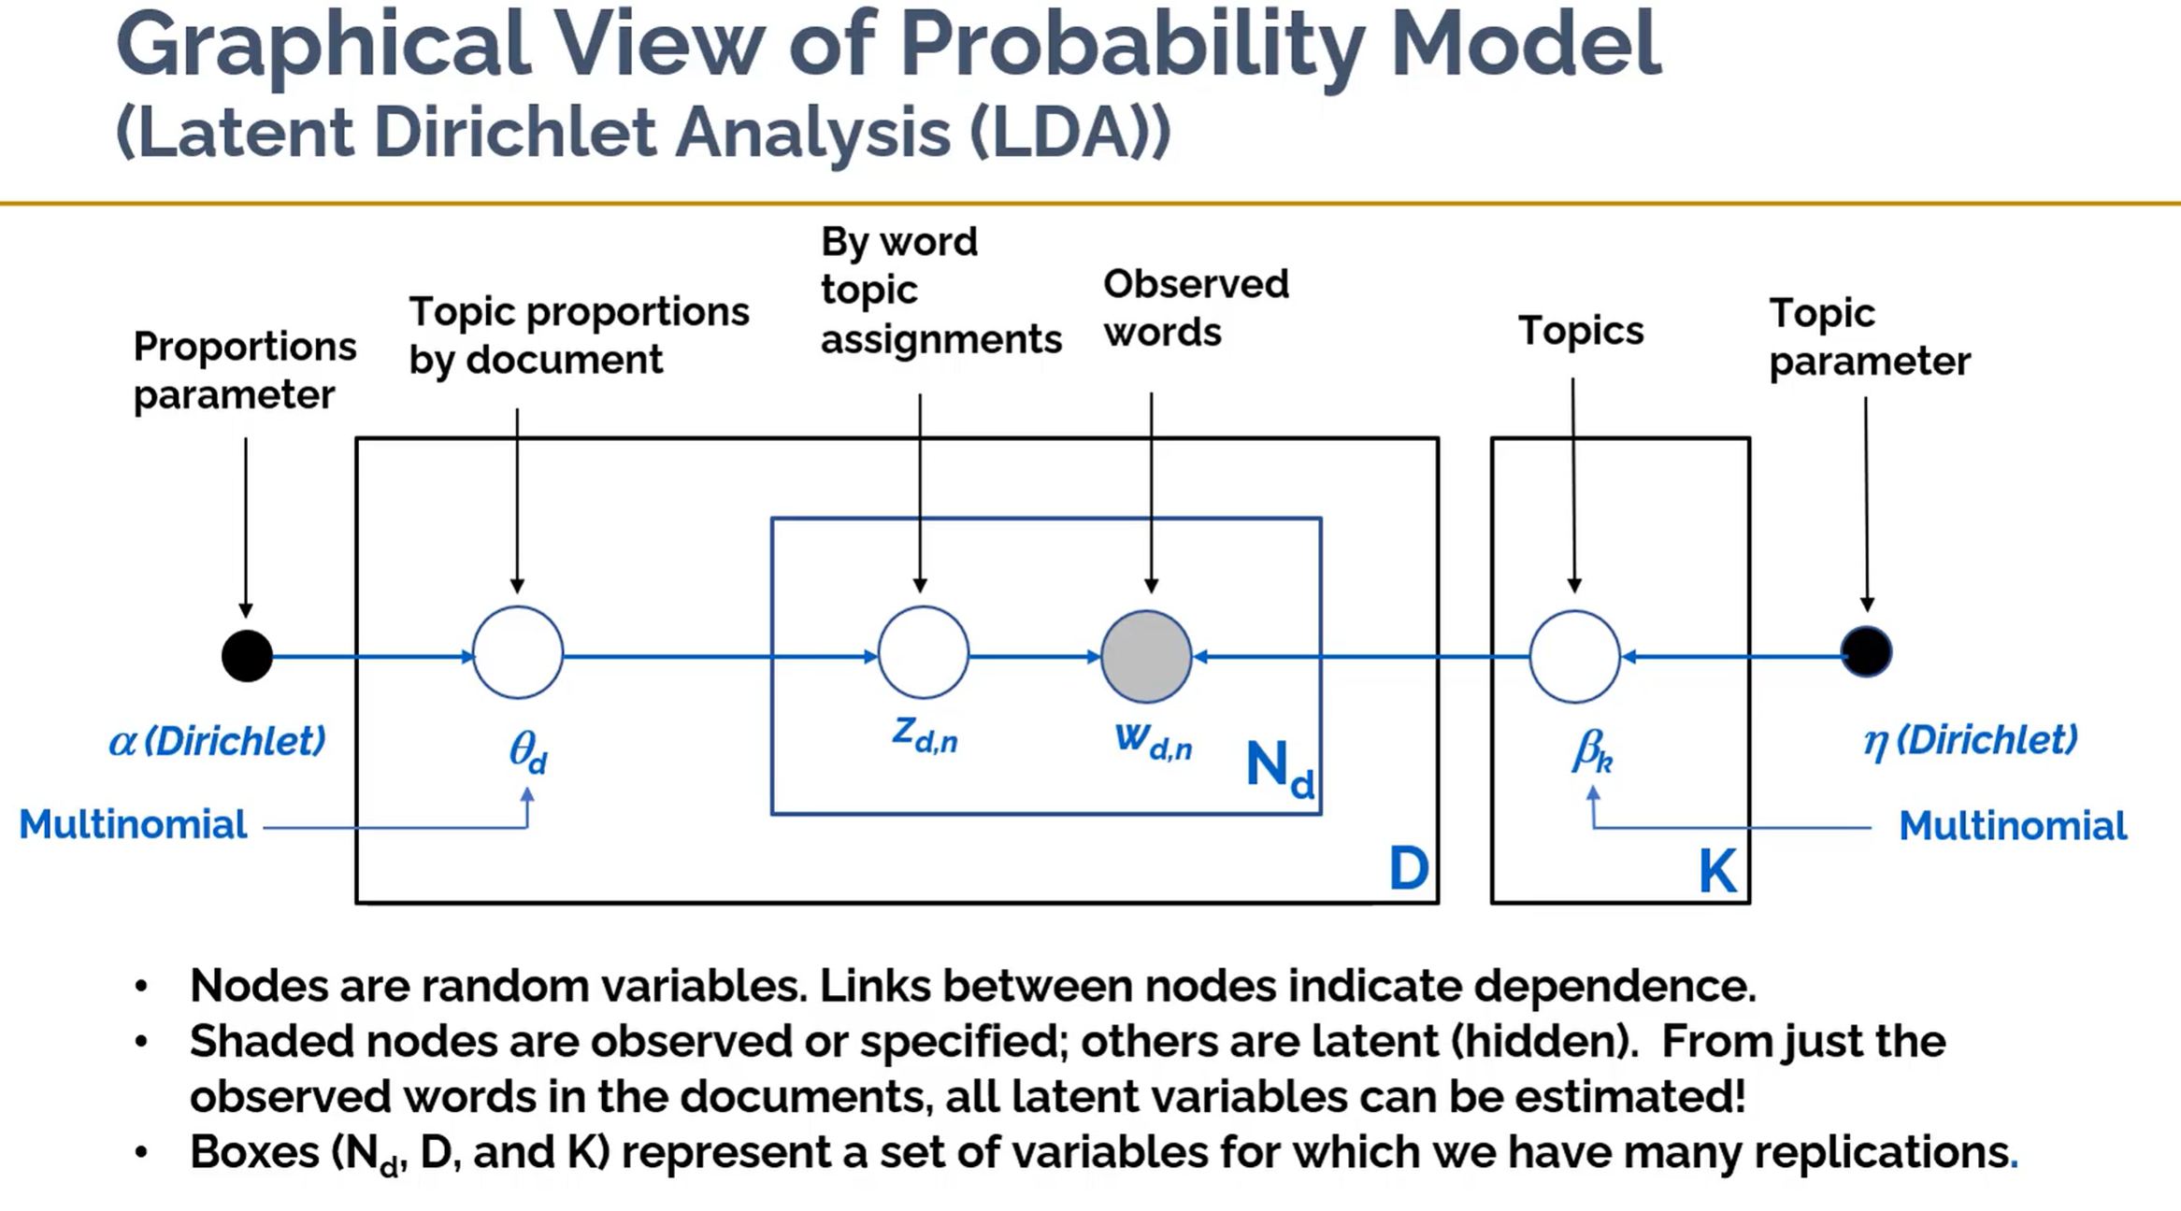
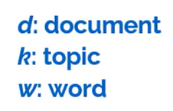

Slide 8
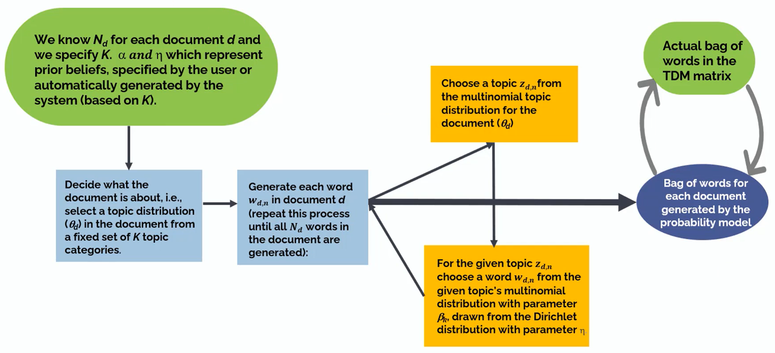
Outline of the Estimation Process

Slide 9
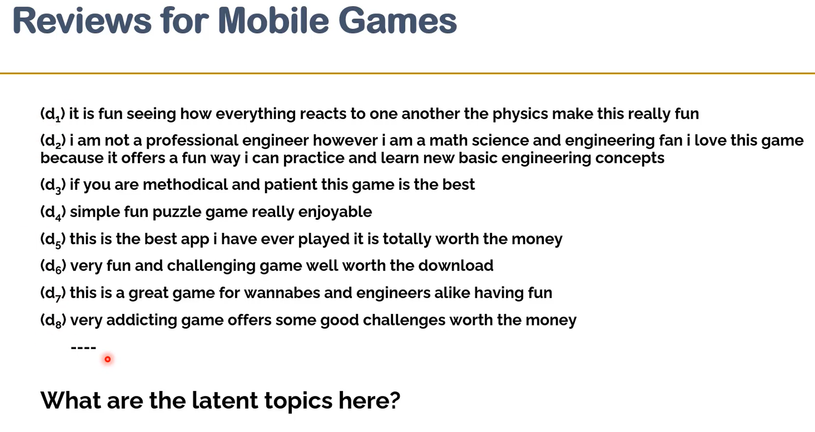

Slide 10
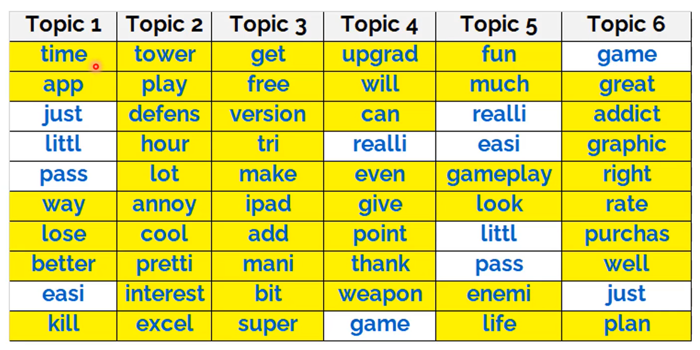
Yellow cells represent unique words in each topic
Words are ordered in each topic from most to least importance.

Slide 11
